Slide 1
: الاسم مي ابراهيم احمد عبد الرحيم سكشن : 9

Slide 2
Project Name :
N-Puzzle

Slide 3
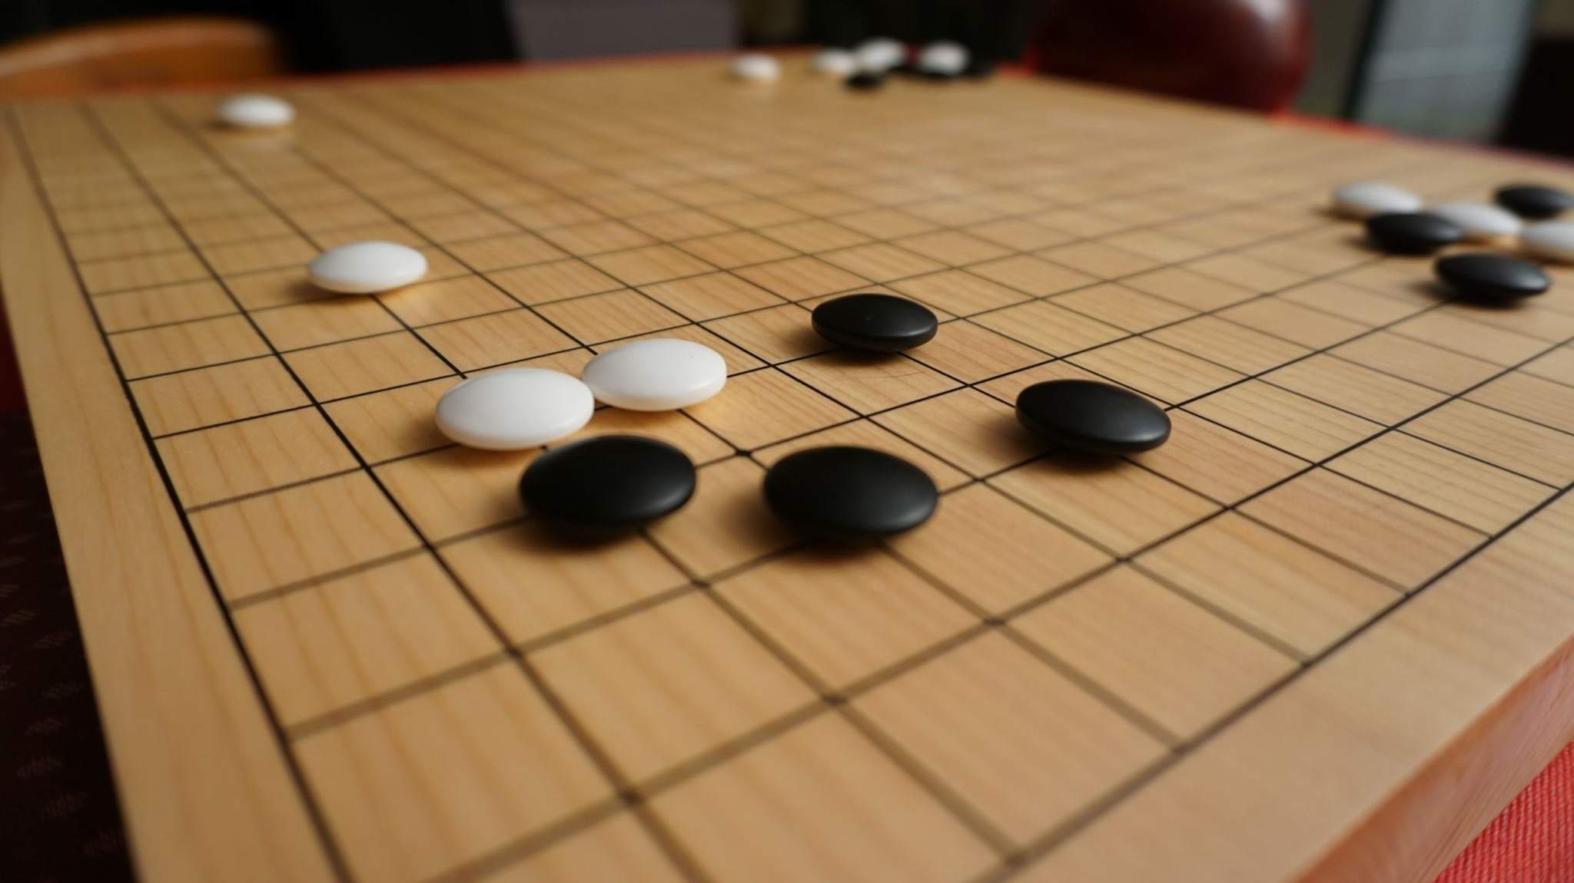
Description :
The game is a board divided into squares , with an empty tile that the user can manually move to try and solve , or solve the game using informed algorithm , and I will implement it using a real image instead of numbers .

Slide 4
Why the project is chosen ?
Because , The project is a fun and interactive project , and it allow you to see the algorithm’s result step by step .

Slide 5
Importance :
1 ) An interactive project suitable for teaching and demonstration in the field of Artificial Intelligence .
2 ) It demonstrates how to use informed search algorithm to solve real world problem

Slide 6
Project goal:
1 ) Solving the game automatically using informed Search algorithm .
2 ) Understanding the algorithm and how to use it .
3 ) Creating an N-Puzzle game with an image instead of numbers .
4 ) Visually demonstrating the solution step by step

Slide 7
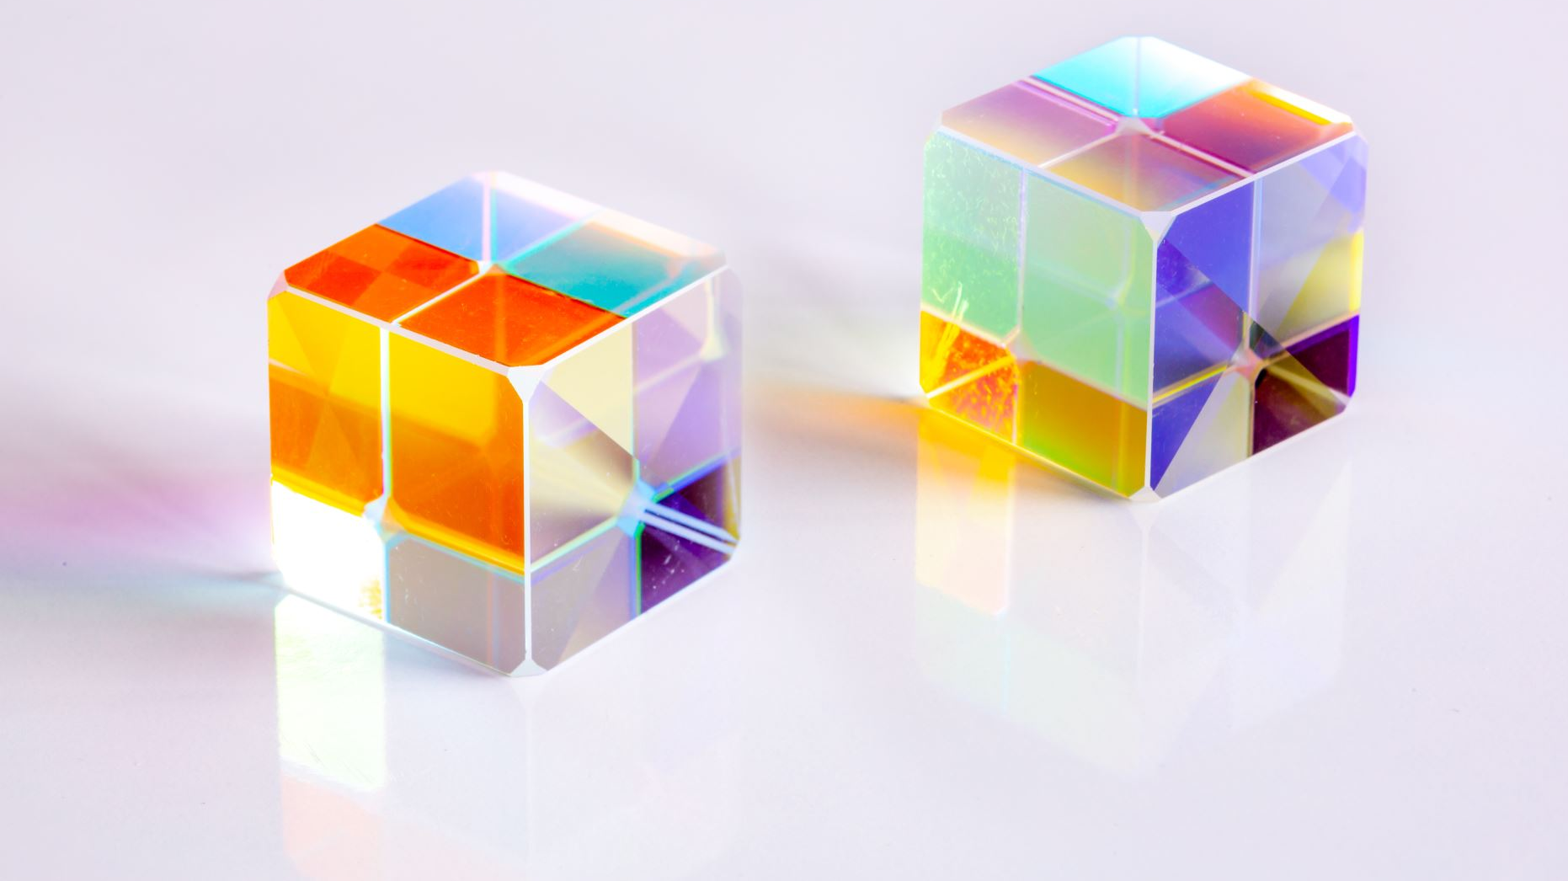
Related Work :
Rubik’s Cube

Slide 8

The algorithm used in the project :
A* Search Algorithm .

Slide 9
PEAS for this project :
1) performance : fast solving , correct solution , minimum moves , and low memory usage .
2 ) Environment : puzzle board , image tiles and empty tile .
3 ) Actuator : Move up , Move down , Move left , Move Right .
4 ) Sensors : empty tile position , board state and goal detection .

Slide 10
ODESA for this project :
1 ) o : Fully observable .
2 ) D : Deterministic .
3 ) E : Sequential .
4 ) S :Static .
5 ) A : Single Agent .
The game is Dicrete .
The N-Puzzle is fully observable , Deterministic , Sequential , Static , Discrete and Single Agent .

Slide 11
What is the type of agent program ?
Goal Based Reflex Agent

Slide 12
PROBLEM FORMULATION
Initial State : Goal State :
one of the random arrangement
3 | 2 | 1
6 | 4
8 | 5 | 7
3 | 2 | 1
6 | 5 | 4
 | 8 | 7

Slide 13
Problem formulation
States : location of tiles .
Successor function : move blank left , right , up , down .
Path Cost : 1 per move .

Slide 14
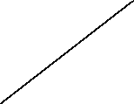

PROBLEM FORMULATION
F(n) = g(n) + h(n)
3 | 2 | 1
6 | 4
8 | 5 | 7
F(n) = 0+3 = 3
3 | 2
6 | 4 | 1
8 | 5 | 7
3 | 2 | 1
6 |  | 4
8 | 5 | 7
3 | 2 | 1
6 | 4 | 7
8 | 5
F(n) = 1+4 = 5
F(n)= 1+2=3
F(n)= 1+4 = 5

Slide 15


Problem Formulation
3 | 2 | 1
6 |  | 4
8 | 5 | 7
3 |  | 1
6 | 2 | 4
8 | 5 | 7
3 | 2 | 1
6 | 5 | 4
8 |  | 7
3 | 2 | 1
 | 6 | 4
8 | 5 | 7
F(n) = 2+3=5
F(n) = 2+1=3
F(n) = 2+3=5

Slide 16


PROBLEM FORMULATION
3 | 2 | 1
6 | 5 | 4
8 |  | 7
3 | 2 | 1
6 | 5 | 4
8 | 7
3 | 2 | 1
6 | 5 | 4
 | 8 | 7
F(n) = 3+2 =5
F(n) = 3+0=3

